Slide 1


Crime Victims An Introduction to Victimology
Chapter 3
Victimization in the United States: An Overview
© 2020 Cengage. All rights reserved.

Slide 2
Learning Objectives (1 of 2)
L01. Describe the uses of statistics in victimology.
L02. Explain how statistics can be given a “spin” to persuade and even mislead.
L03. Describe how victimologists estimate how many people are harmed by criminal activities.
L04. Discuss the kinds of data found in the Federal Bureau of Investigation’s annual Uniform Crime Report.
L05. Explain how the FBI’s National Incident-Based Reporting System is preserving information about victims from police files.

Slide 3
Learning Objectives (2 of 2)
L06. Describe the kinds of data found in the Bureau of Justice Statistics’ annual National Crime Victimization Survey.
L07. List the strengths and weaknesses of victimization statistics from government sources.
L08. Identify trends in victimization in the United States according to official statistics.
L09. Identify trends in violent crime rates in the United States from the twentieth century to present times.
L010. Identify the comparative risks of becoming a victim of crime as opposed to suffering other calamities.

Slide 4
Victimization across the Nation: The Big Picture

Slide 5
The Big Picture
Big picture data come from
Official government statistics
Criminologists and victimologists
Special interest groups
Statistical portraits answer questions such as
How many people are harmed by criminals each year?
Is victimization increasing or subsiding?
Which groups are targeted most/least?
When and where do crimes occur?

Slide 6
Making Sense of Statistics
Official statistics are compiled by government agencies.
Statistics are used to
Estimate victimization rates
Expose patterns of criminal activity
Detect trends, or changes over time
Estimate costs and losses
Project rough estimates of next year’s caseload
Evaluate effectiveness of policies and prevention strategies
Identify statistical profiles of typical victims

Slide 7
Detecting the Abuse of Statistics
Statistics are interpreted based on the spin given them to
Influence decision makers
Shape public opinion
Statistical abuse involves
Manipulation of what is being measured
Victimologists should ask themselves
What is the origin of these data?
Are different estimates available from other sources?
What kinds of biases could have crept into the analyses?
How valid and precise were the measurements?
How were the key variables operationalized?

Slide 8
Discussion Question 1
Some cynics say statistics offer the user the "veneer of objectivity." What does this mean? Do you think U.S. political figures knowingly spin data to further their careers?

Slide 9
The two official sources of data

Slide 10
Facts and Figures in the Federal Bureau of Investigation’s Uniform Crime Report (UCR) (1 of 3)
Established in 1927 to
create a standard set of definitions and reporting formats for gathering crime statistics.
compile all victims’ complaints and direct observations made by officers across the country.

Slide 11
Facts and Figures in the Federal Bureau of Investigation’s Uniform Crime Report (UCR) (2 of 3)
  Part I
  Eight index crimes
    Against persons: murder, rape, robbery, and aggravated assault
    Against property: burglary, larceny, motor vehicle theft, and arson
  Used to compute an overall crime index
  Part II
  21 assorted offenses
    Simple assault, curfew offenses and loitering, embezzlement, forgery and counterfeiting, disorderly conduct, driving under the influence, drug offenses, fraud, gambling, liquor offenses, offenses against the family, prostitution, public drunkenness, runaways, sex offenses, stolen property, vandalism, vagrancy, and weapons offenses
  Provides only arrest numbers

Slide 12
Facts and Figures in the Federal Bureau of Investigation’s Uniform Crime Report (UCR) (3 of 3)
Problems with the UCR
Underreporting results in incomplete data
Focuses on accused offenders with no complainant information
Combines attempted and completed crimes
Crime rates include incidents against impersonal entities and individuals
FBI requires observance of the hierarchy rule in reporting
National Incident-Based Reporting System (NIBRS)
Standard format by 2021
Abandons the hierarchy rule
Provides expanded coverage of illegal activities
  46 Group A offenses from 22 crime categories
  Victim information

Slide 13
Facts and Figures in the Bureau of Justice Statistics’ National Crime Victimization Survey (NCVS) (1 of 2)
Self-report survey of a nationwide sample of households
Respondents answer questions from a 20-page survey every 6 months for 3 years
Focuses on crimes of violence and simple assault, not murder
Inquires about personal larceny, burglary, larceny, and motor vehicle theft
Records demographics and perceptions of the victims
Used to derive estimates of crimes throughout the United States

Slide 14
Facts and Figures in the Bureau of Justice Statistics’ National Crime Victimization Survey (NCVS) (2 of 2)
Problems with the NCVS
National sample may not be representative of the U.S. population.
Credibility in self-reported information is questionable.
  Underreporting/memory decay
  Overreporting/forward telescoping
Interviewers’ experience affects data collected.
Huge samples are required, leading to great expense.
Seriousness of crime in certain areas is indeterminable.
Projected absolute number of incidents and relative rates are estimates at the midpoint of a range (or confidence interval).

Slide 15
Comparing the UCR and NCVS
Strengths of the UCR:
Contains homicide information
Provides geographically based statistics
Based on law enforcement reports, adding authenticity
Strengths of the NCVS:
Contains victim information
Provides data about incidents not reported to police
Unaffected by the relationship between police and the community
  Findings of the UCR and NCVS are not comparable because
  Definitions of crimes (e.g., rape, robbery, burglary) change the numerator
  Denominators differ

Slide 16
A First Glance at the Big Picture: Estimates of the Number of New Crime Victims Each Year
For 2016, UCR reports nearly
1.25 million acts of “violence against persons”
9 million property crimes
For 2016, NCVS reports nearly
5.7 million acts of “violence against persons”
16 million property crimes

Slide 17
A Second Look at the Big Picture: Watching the FBI’s Crime Clock
The Crime Clock
As time passes, the victim toll keeps mounting
Total number of reported incidents of each crime is divided into the number of seconds or minutes in a year
Based on the UCR, so data underestimates crime in the United States
Represents the annual ratio of crime to fixed time intervals, not the predictability of crime
Can feed into media sensationalism and fear-mongering

Slide 18
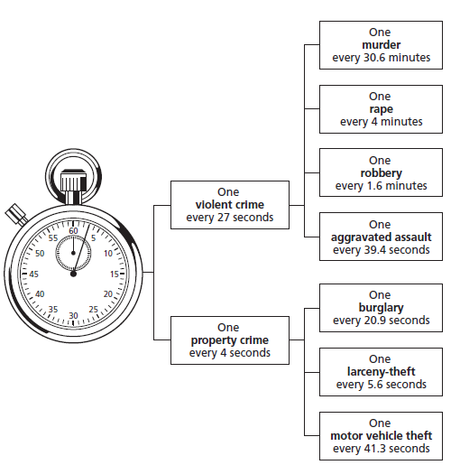
Figure 3.1: The FBI’s Crime Clock, 2016

Slide 19
Delving Deeper into the Big Picture: Examining Victimization Rates
Victimologists study
Raw numbers
Rates to compare the frequency of crime in populations of unequal size
  Victimization rates
  Must be viewed in context or they imply that being targeted is commonplace
  Ignore the fact that most Americans go unscathed each year

Slide 20
Tapping into the UCR and the NCVS to Fill in the Details of the Big Picture
Property crimes
Are more common than violent crimes
Tend to occur in the following frequency:
  Larceny, mostly petty
  Burglary
  Motor vehicle theft
  Violent crimes
Tend to occur in the following frequency:
    Simple assaults (punching, kicking, shoving, slapping)
    Aggravated assaults (shootings, stabbings)

Slide 21
Table 3.1 Estimated Nationwide Victimization Rates from the UCR, 2016
Crime | Definition | Incidents | Rate (per 100,000)
FBI’s UCR
Murder | The willful (nonnegligent) killing of one human being by another; includes manslaughter and deaths due to recklessness; excludes deaths due to accidents, suicides, and justifiable homicides. | 17,250 | 5.3
Rape | Penetration, no matter how slight, of the vagina or anus with any body part or object, or oral penetration by a sex organ of another person, without the consent of the victim; includes attempts. | 131,000 | 40
Robbery | The taking of or attempting to take anything of value from the care, custody, or control of a person or persons by force or threat of force; includes commercial establishments and carjackings, armed and unarmed. | 332,000 | 103
Aggravated Assault | The unlawful attacking of one person by another for the purpose of inflicting severe bodily injury, often by using a deadly weapon; includes attempted murder and severe beatings of family members; excludes simple, unarmed, minor assaults. | 803,000 | 249
Simple Assault | No weapon used, minor wounds inflicted. | Not measured | Not computed
Burglary | The unlawful entry of a structure to commit a felony or theft; includes unlawful entry without applying force to residences and commercial and government premises. | 1,515,000 | 469
Larceny-Theft | The unlawful taking, carrying, leading, or riding away of property from the possession of another; includes purse snatching, pocket picking, thefts from vehicles, thefts of parts of vehicles, and shoplifting; excludes the use of force or fraud to obtain possessions. | 5,638,000 | 1,745
Motor Vehicle Theft | The theft or attempted driving away of vehicle; includes automobiles, trucks, buses, motorcycles, snowmobiles, and commercially owned vehicles; excludes farm machinery and boats and planes. | 765,000 | 237

Slide 22
Table 3.1 Estimated Nationwide Victimization Rates from the NCVS, 2016
Crime | Definition | Incidents | Rate (per 100,000)
BJS’s NCVS Definitions
Murder | Not included in the survey. | Not measured | Not computed
Rape/Sexual Assault | The unlawful penetration of a male or female through the use of force or threats of violence; includes all bodily orifices, the use of objects, and attempts as well as verbal threats.Sexual assaults are unwanted sexual contacts, such as grabbing or fondling; includes attempts and may not involve force; excludes molestations of children under 12. | 323,000 | 120
Robbery | The taking directly from a person of property or cash by force or threat of force, with or without a weapon; includes attempts; excludes hold-ups of commercial establishments. | 501,000 | 180
Aggravated Assault | The attacking of person with a weapon, regardless of whether an injury is sustained; includes attempts as well as physical assaults without a weapon that result in serious injuries; excludes severe physical abuse of children under 12. | 1,084,000 | 400
Simple Assault | The attacking of person without a weapon resulting in minor wounds or no physical injury; includes attempts and intrafamily violence. | 3,841,000 | 1,410
Household Burglary | The unlawful entry of residence, garage, or shed, usually but not always, for the purpose of theft; includes attempts; excludes commercial or governmental premises. | 3,291,000 | 2,470 (per 100,000 households)
Theft | The theft of property or cash without contact; includes attempts to take possessions and stealing by persons invited inside. | 12,040,000 | 9,030 (per 100,000 households)
Motor Vehicle Theft | The driving away or taking without authorization of any household’s motorized vehicle; includes attempts. | 586,000 | 440 (per 100,000 households)

Slide 23
Discussion Question 2
How does the precise wording of crime definitions affect the statistics derived from them? Do you think the #MeToo movement will have any affect on the UCR’s definition of rape?

Slide 24
Searching for Changes in the Big Picture: Detecting Trends in Interpersonal Violence and Theft
Crime trends in the big picture include
Spikes: Sudden jumps in crime rates
Crime waves: Sharp increases in rates, continuing over consecutive years
Crime crashes: Downward crime rates year-after-year
Crime trends in the United States revealed by the UCR and NCVS
Major crime wave during the late 1960s
Violent crime “crash” in the 1990s, drifting downward until 2014
Uptick in violent crime in 2016

Slide 25
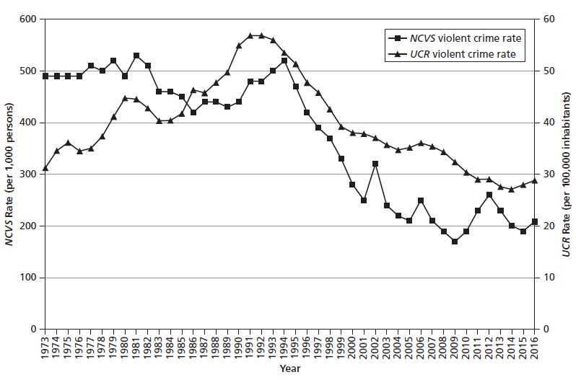
Figure 3.2 Trends in Violent Victimization Rates, United States, 1973-2016

Slide 26
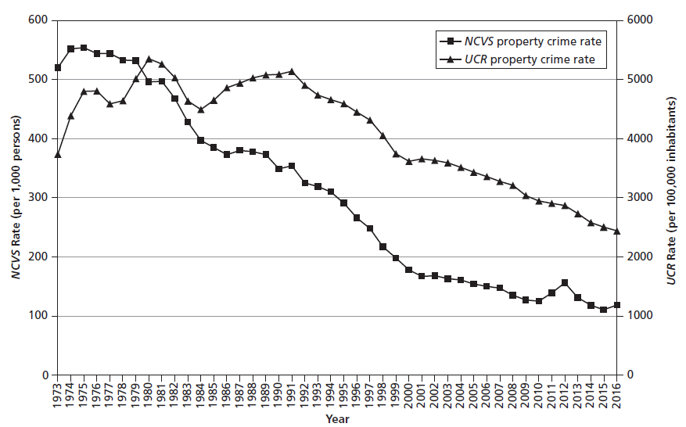
Figure 3.3 Trends in Property Crime Rates, United States, 1973-2016

Slide 27
Taking a Longer View: Murders in the United States Over the Past Century

Slide 28
Types of Murder
Homicide
Killing of one human being by another
Not always punishable
First-degree murder
Killing with express malice, deliberately, or with premeditation
Second-degree murder
Killing with intent to inflict grievous bodily injury or with a depraved heart
Voluntary (or first-degree) manslaughter
Killing in the sudden heat of passion resulting from victim’s provocations
Involuntary (second-degree) manslaughter
Loss of life due to gross negligence

Slide 29
The Rise and Fall of Murder Rates Since 1900
Homicide rates soared from 1900 until the peak in 1933.
Violent deaths plummeted after Prohibition, continuing to fall until 1945, the end of World War II.
Homicide rates briefly surged after World War II, then declined.
Homicide rates doubled during the 1960s to the mid-1970s.
Lethal violence reached an all-time high in 1980.
In the 1990s, murder rates began a decline until the recent uptick in 2015.

Slide 30
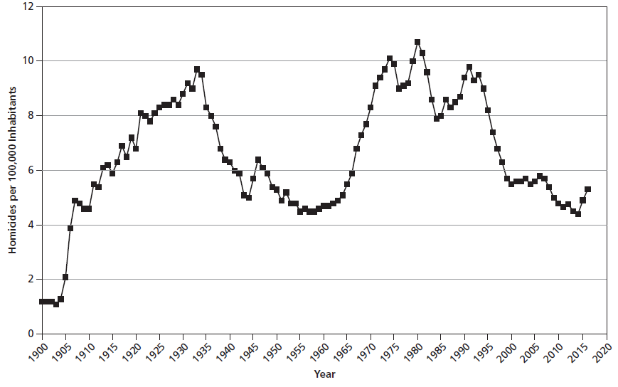
Figure 3.4 An Historical Overview of Homicide Rates, United States, 1900-2016

Slide 31
PUTTING CRIME INTO PERSPECTIVE: THE CHANCES OF DYING VIOLENTLYOR FROM OTHER CAUSES

Slide 32
Comparative Risks
Comparative risks
Rest on likelihood of experiencing negative life events
Determine which threats merit greater precautionary measures
Problems with comparative risks include
Ranking represents a snapshot of a fluid situation
Cannot indicate underlying trends

Slide 33
Table 3.2 Comparing the Risks of Death Posed by Crime, Accidents, and Certain Diseases, 2015 and 2016
Cause of Death | Death Rate per 100,000 All Ages 2016 | Death Rate per 100,000, 20–24 Year Olds, 2015
All causes | 728 | 89
1) Heart problems (cardiovascular disease) | 166 | 3
2) Cancers (malignant neoplasms) | 156 | 4
3) Accidents (unintentional injuries and fatal drug overdoses) | 47 | 38
4) Lung problems (pulmonary and respiratory diseases) | 41 | Fewer than 1
5) Strokes (cerebrovascular disease) | 37 | Fewer than 1
6) Alzheimer’s disease | 30 | Fewer than 1
7) Diabetes | 21 | Fewer than 1
8) Influenza and pneumonia | 14 | Fewer than 1
9) Kidney problems (nephritis) | 13 | Fewer than 1
10) Suicides (intentional self-harm) | 14 | 15
Homicides (including legal intervention as well as deadly assaults) | 5 | 14

Slide 34
Discussion Question 3
Homicide is the third leading cause of death for young adults behind accidents and suicides. Why does homicide continually receive more media coverage than the other causes? Would more coverage of deaths by overdose or by motor vehicle accident affect a young person's behavior?

